Slide 1



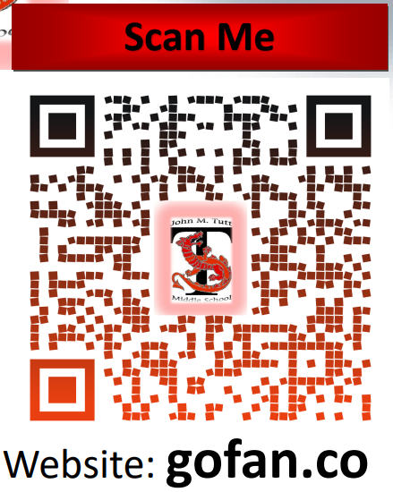

Dr. Cristi Cole
Athletic Director &
In-School Suspension Teacher
ATTENTION!
All Middle School athletic events will require a ticket.
Purchase Tickets via GoFan
TUTT MIDDLE.pdf
Cheerleading Tryouts will be May 7th, 8th & 9th 2025
Football Tryouts will occur in August 2025.
Specifics are located in the Tryout Tabs for each sport. See information below for all needed documentation. Students must be cleared prior to ANY attendance or participation.
To be eligible for play students must have a physical packet completed prior to attending practice/play. Submit completed packets before tryouts to be verified/cleared. The forms are posted on Tutt’s website.
The Physical Packet (Includes 11 pages):
  Athletes Checklist
  History Form
  Physical Form
  Clearance Form
  Athletic Roster
  Parent Permission Form
  Student/Parent Concussion Form – (for each sport played)
  Interscholastic Contract
  Awareness of Football Risk Form - (Football Only)
  Cardiac Form – (for each sport played)
  Emergency Medical Card
  ***ATHLETE MUST ALSO PROVIDE THE FOLLOWING ITEMS:
    Copy of Insurance Card (front & back)
    Academic Clearance - (Athletic Director)
    Copy of last Report Card
TMS Athletics
Contact Information
colecr@boe.Richmond.k12.ga.us
Tutt’s # 706-737-7277
Room #228

